Slide 1


Explore Vibes
Presented By-
Bagal Dnyaneshwar Vachishtha(239015)
Rishabh Subhabh Jaiswal(239035)

Slide 2
Project Introduction
The main purpose of Tour and travels management system is to provide a best facility and travelling services for a customer to book hotels, flight and bus ticket for trip purpose. We have developed tour and travels management system to provide a search platform find their tour places according to their choices. This is instead of to provide the best traveling services to the customers and travel agents. We have expanded tours and travel administration strategy to provide an exploration platform where a tourist can find their trip spots according to their choices.

Slide 3
Objective (Purpose):
The main purpose of “Tours and travels management system” is to provide a convenient way for a customer to book vehicle or whole package for tour purposes.
The objective of the project is to develop a system that automates the processes and activities of a travel agency.

Slide 4
Scope:
This type of software’s can be further extended for generating reviews related to the tourist requirements.
• Also, can be used for generating reviews for the Online Videos provided on the software.
• Easy to find the nearby famous places, temples & monuments.
• Developer can be providing the update information of the places and also provide updates to the software for better serves.

Slide 5
Technology Used:
Front End: ReactJS
Back End: Java Spring Boot API.
Database: MySQL

Slide 6
S/W and H/W Requirements
Server Side:
Processor: Intel core i3
RAM: 4GB or above
Client Side (minimum requirement):
Processor: Intel Dual Core
OS: Windows

Slide 7
Functionalities - Module wise /user wise
Explore Vibes consists of two modules named below
1. Admin
2. Customer/User
User Roles:
Admin : Admin can login to the system.
Admin : login, add packages, delete packages, remove user.
Customer/User : register itself, logins ,update her/his details, view hotels, add packages.

Slide 8
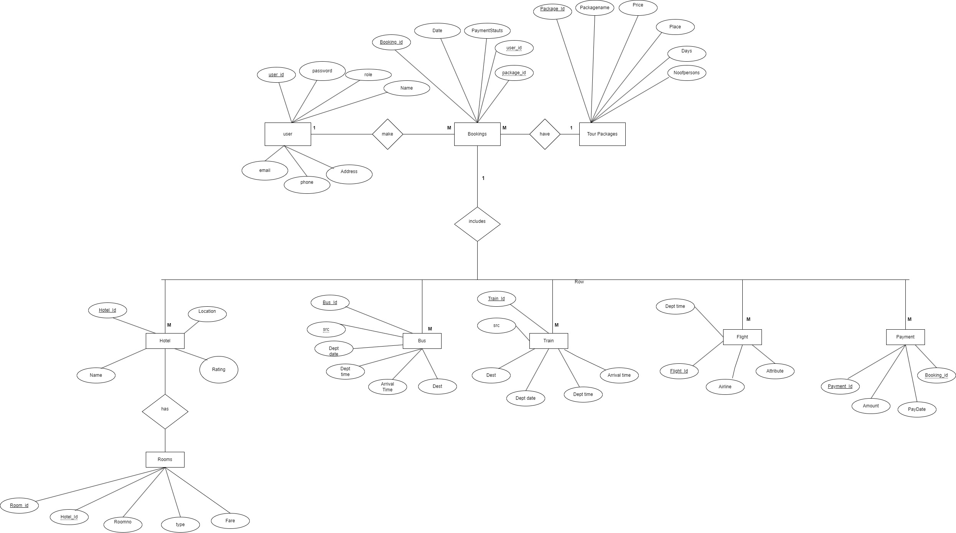
UML Diagrams: E-R Diagram

Slide 9
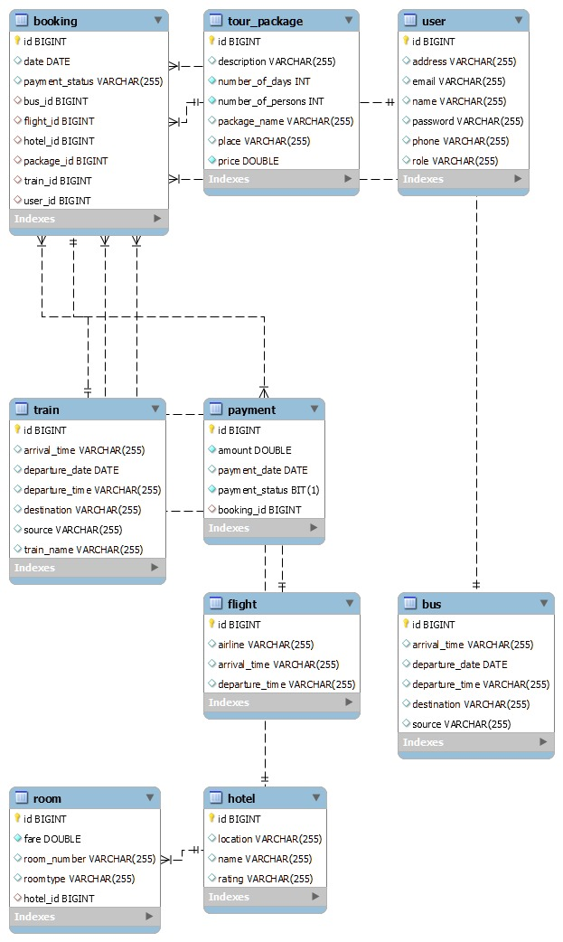
Class Diagram(MySQL Auto generated)

Slide 10
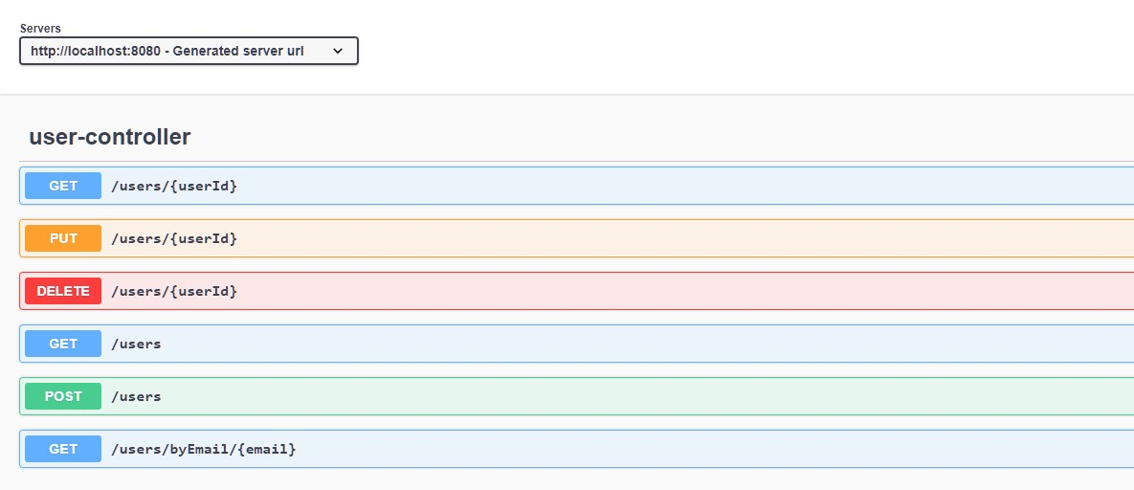
User Controller

Slide 11
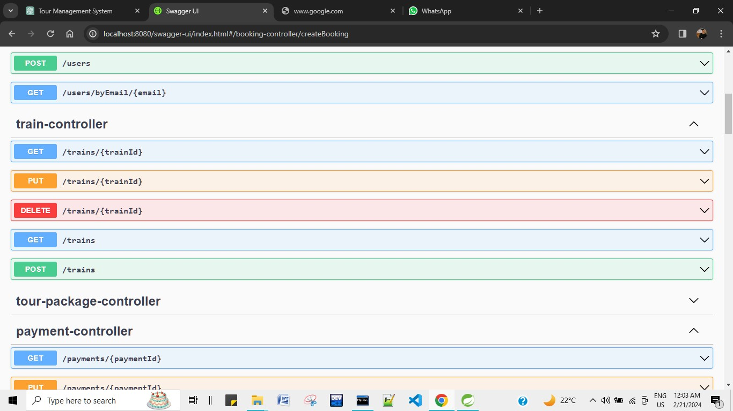
Train Controller

Slide 12
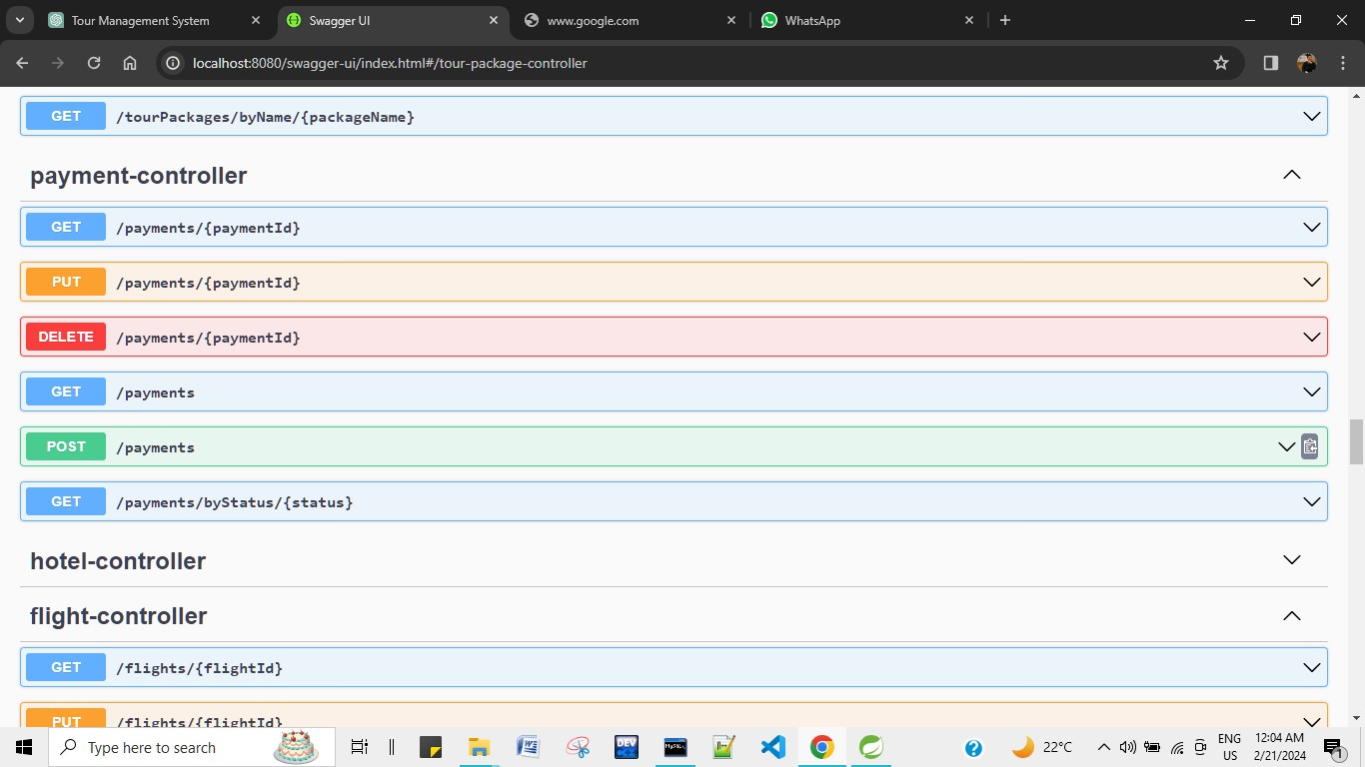
Payment Controller

Slide 13
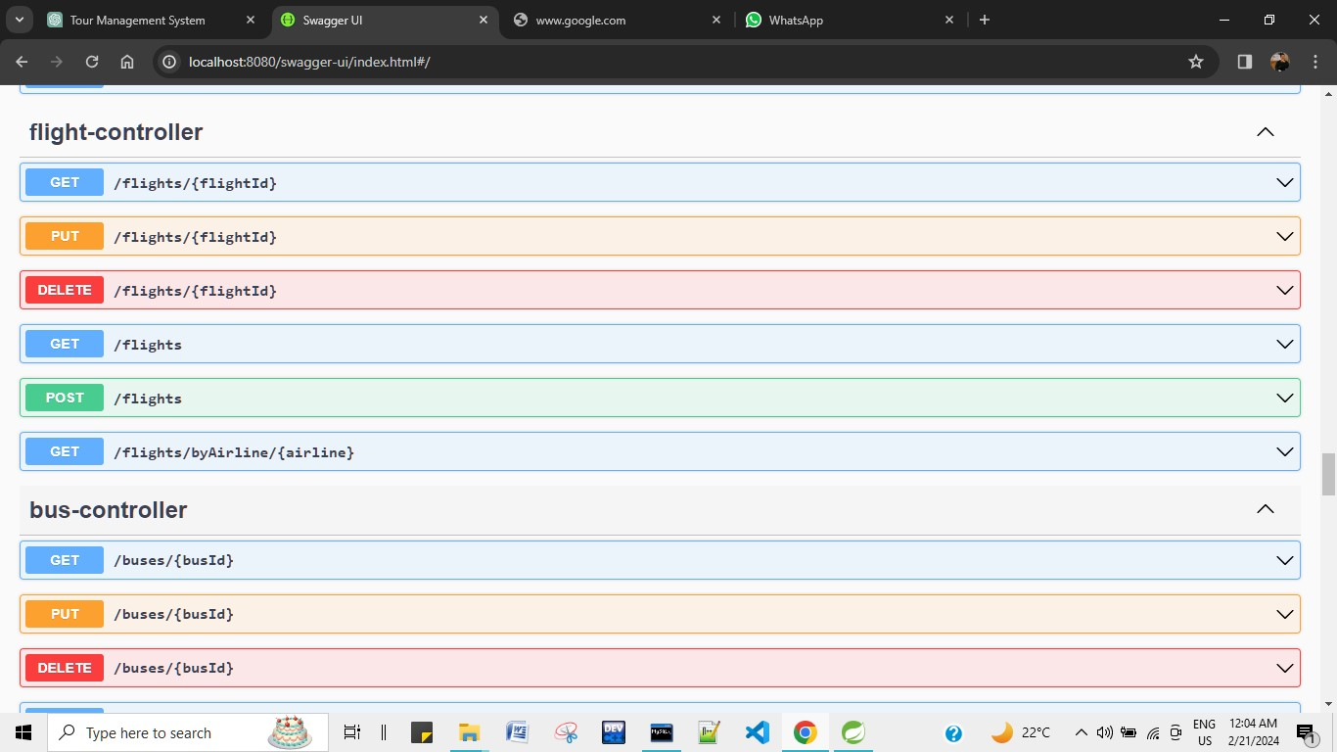
Flight Controller

Slide 14
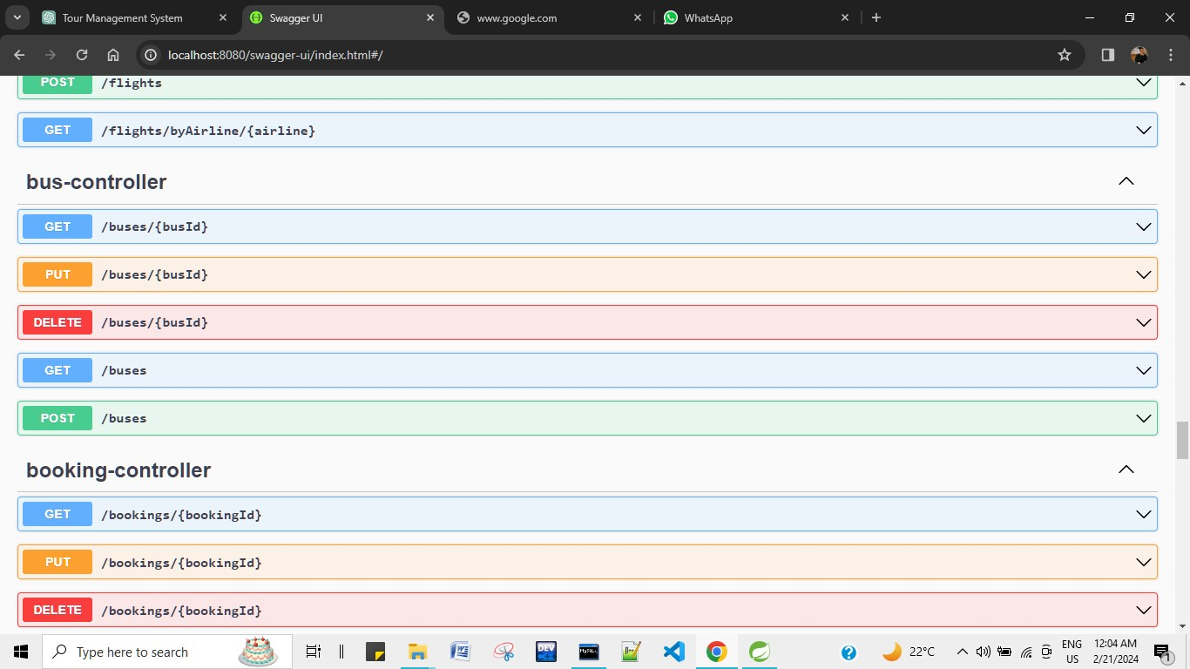
Bus Controller

Slide 15
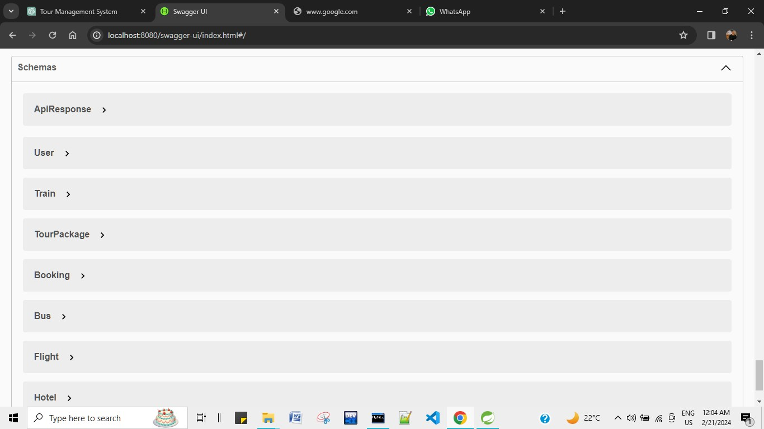
Schemas

Slide 16
Futures Scope
v We will include more functionality as per user require.
v Multiple package can booked by one customer at a time.
v Updated feature should enhanced for all modules.
v Real-time feedback facility available on our website.
v Travels management system will try to serve all expectations.

Slide 17
Conclusion
Here we have presented the design of a tour management system ExploreVibes that can provide the users with the required tourism guidance required anytime and anywhere.
This is a combination of smartphone and Internet services.
The tour management website contributes a reasonable way for the users to schedule their trips, since it provides detailed information about the tourist places including description, image.
This method includes various features/services such as delivering customized packages, the distance between the source and destination location,online ticket booking a combination of smartphone and Internet services

Slide 18
References
•https://reactjs.org/docs/getting-started.html
•https://docs.spring.io/spring-boot/docs/current/reference/htmlsingle/
•https://developer.mozilla.org/en-US/docs/Web/JavaScript
•https://docs.oracle.com/en/java/
•https://dev.mysql.com/doc/
•https://www.eclipse.org/documentation/
•https://code.visualstudio.com/docs/

